Slide 1




Demystifying Open Source Network Operating Systems
Senthil Kumar Ganesan
Dell Technologies
@skg-net
https://www.linkedin.com/in/skgnet/

Slide 2
Disaggregation
Protocol / Application
Network Abstraction
Hardware
&
Software
Closed Software
Platform Abstraction
Open Hardware
Open Hardware
Integrated
Disaggregated H/W & S/W
Disaggregated H/W & Modular S/W
Rich Feature Set
Pre Integrated & Tested
Single Point Support
H/W Independence
Power of choice
Cost Efficiency
Innovation
Development Speed
Cost Efficiency
Modern Operating Paradigms
Notes:
I would like take moment to quickly talk about Disaggregation & Open Networking before we dive into Open Source Network Operating Systems. What you see on your left traditional Integrated solution. Integrated solution provided a rich feature set, Pre-integrated & tested, single point of support. In the Middle is the Open Networking – Disaggregated H/W & S/W. Open means choices and options, It provides you with the Power of Choices. Orgs can achieve greater benefits by choosing from best-of-breed open networking platforms, operating systems and applications. Right - > This is where we are moving towards – Disaggregated H/W & Modular S/W. Accelerated innovation, Simplification. In earlier keynote we learned about common abstracted key value store in Lean NFV, with the help of common abstracted interface. All the application, components can be iterated independently providing innovation & development speed.
Question to you all? How many open networking - operating systems are there currently available.

Slide 3





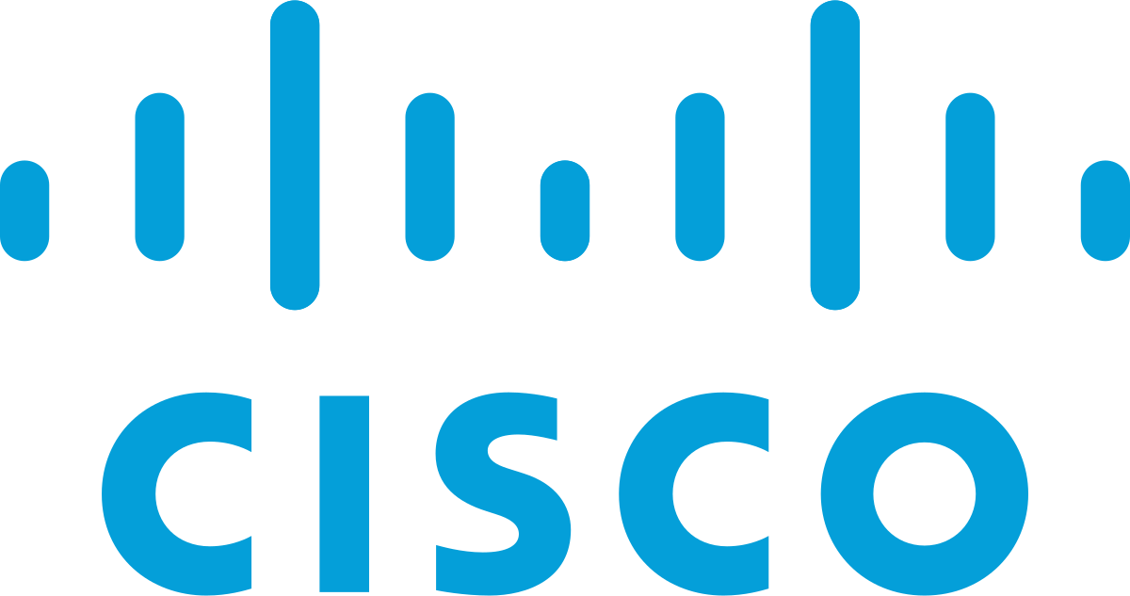






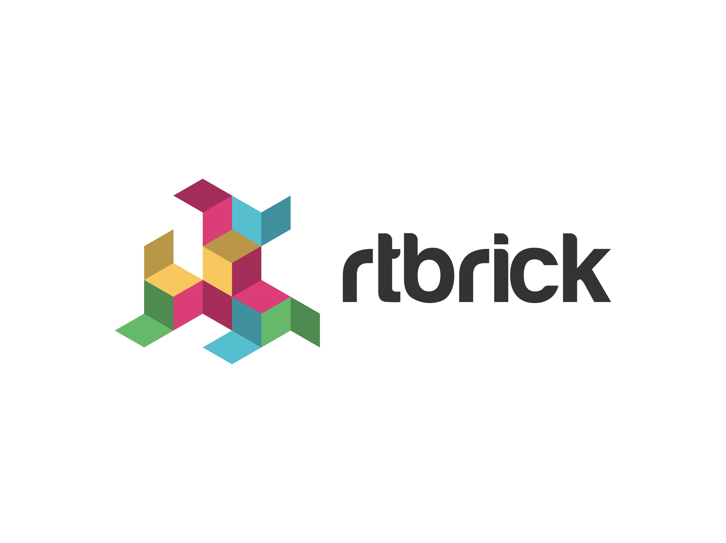
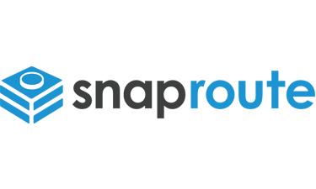







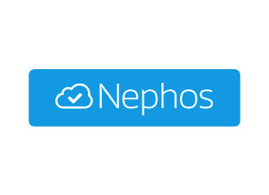
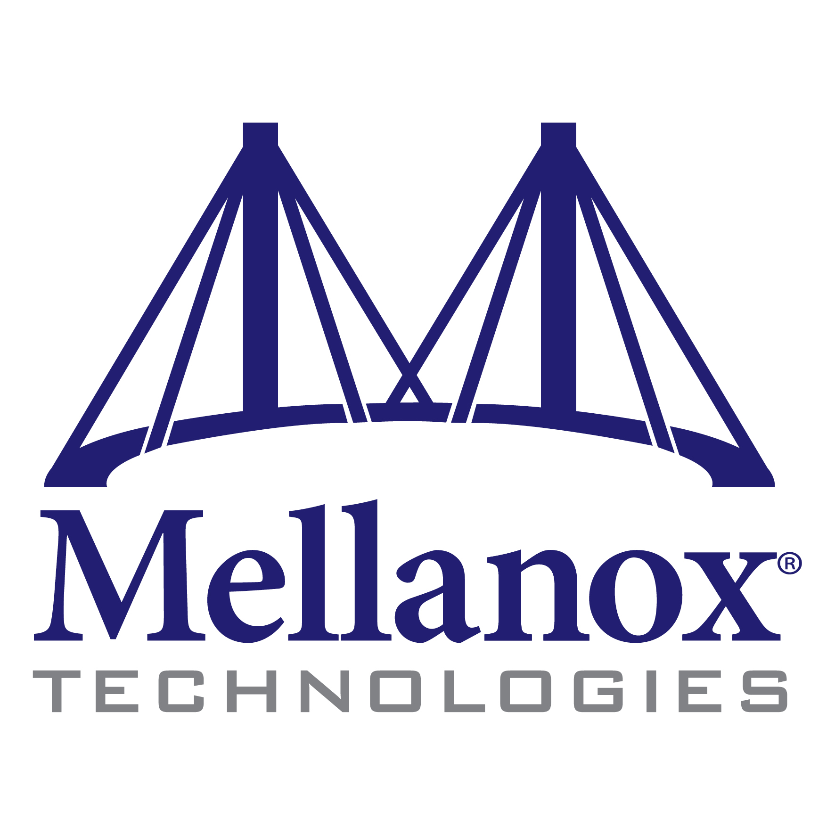
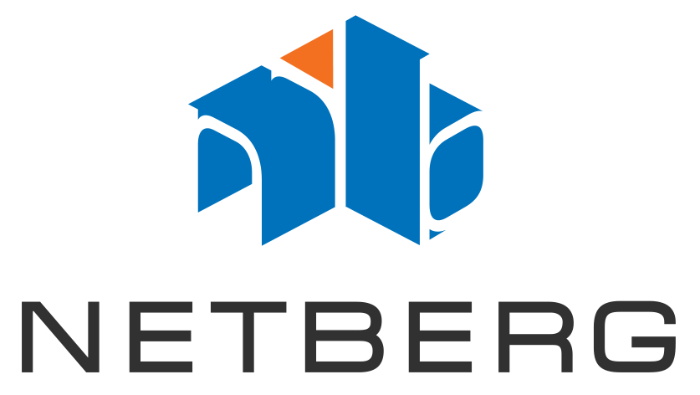


Open Networking – Network Operating Systems
Closed Software
Open Hardware
Notes:
~ 15 vendors, if I missed some of the logos apologize for the same. You can see the power of choices. You can also see all major traditional slowly recognizing and moving towards open networking.

Slide 4
Anatomy of a Network Switch and OS
Infrastructure Layer
Management Layer
Network Infrastructure Management
(IPC, logging, etc)
CLI
SNMP
Netconf
REST
GNMI
Protocol / Application Layer
BGP
STP
LACP
ACL
QoS
Abstraction Layer
Platform Abstraction
NPU Abstraction
Operating System
Drivers
Platform Drivers
NPU Drivers
Bootloader
HW
CPU
Peripherals
(FAN, LED, Sensors etc)
NPU
Notes:
Let's understand the components of Network Operating System, this is critical to understand the Open Source Network Operating System. This show for a pizza boxes. Networking H/W

Slide 5
Open Networking Components
OpenConfig
OpenConfig provides a consistent set of vendor-neutral data models (written in YANG) based on actual operational needs from use cases and requirements from multiple network operators.
Openconfig is supported by most of the major networking vendors.
Provides management layer abstraction – thus enabling common management or controller application to be written.
Uses modern RPC - NETCONF, RESTCONF, GNMI - GRPC
Open Networking Linux
A Linux Distribution for Open Networking Switches
Reference NOS for the Open Compute Project (OCP)
~120 H/W Platforms supported, becoming the defacto standard.
Uses Debian and stock LTS Linux kernel
Provides Platform Abstraction, via ONLP API
Open Network Install Environment
Modern, Efficient Network Installer
Open Compute Subproject, initially contributed by Cumulus
Defacto standard boot loader, its a small operating system, pre-installed as firmware on bare metal network switches.
Provides an environment for automated operating system provisioning
~161 devices currently supported.
Switchdev
The Ethernet switch device driver model (switchdev) is an in-kernel driver model for switch devices which offload the forwarding (data) plane from the kernel.
Provides Network Abstraction – currently only Mellanox is supported
Offloads L2 & L3 from Linux Kernel and aims to re-use the same set of linux network tool set for switches
Switch Abstraction Interface
SAI defines API to provide a vendor-independent way of controlling forwarding elements, such as a switching ASIC, an NPU or a software switch in a uniform manner.
SAI helps easily port new ASIC by running the same application stack on all the hardware, enabled by a simple, consistent programming interface.
CRUD operation over extensible Entity/Attribute/Value data model
Provides Network Abstraction for all major ASIC vendors (Barefoot, Boardcom, Cavium, Innovium, Mellanox)
ONIE
ONL
SAI
OpenConfig
Switchdev
ONIE
ONL
SAI
OpenConfig
switchdev
ONIE
ONL
SAI
OpenConfig
switchdev
ONIE
ONL
SAI
OpenConfig
switchdev
ONIE
ONL
SAI
OpenConfig
switchdev
ONIE
ONL
SAI
OpenConfig
switchdev

Slide 6







Open Source Network Operating Systems
Winding Down
Present
Upcoming
LibreSwitch
FlexSwitch
Notes:
Stratum – will be available in Q2 Summer
AT&T DANOS announced.

Slide 7
Open Source Network Operating Systems
Based on Debian Linux
Build your own
Opensource protocol stacks
Layer 3 Uses cases
Abstraction
Notes:
Its uses one or more components we discussed earlier (ONIE, ONL, SAI etc)
Typically using a stock Debian kernel

Slide 8
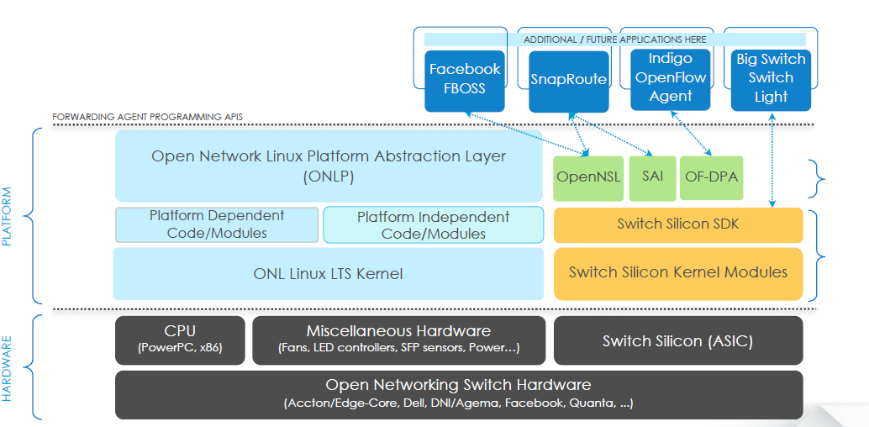
Open Networking Linux (ONL)
Infrastructure Layer
Management Layer
Network Infrastructure Management
(IPC, logging, etc)
CLI
SNMP
Netconf
REST
GNMI
Provides Platform Abstraction
Support Multiple forwarding agents
Thin OS with Controller (ONOS)
Thick OS with FRR/ORC
Becoming the de-facto standard for platform abstraction ~120 platforms (Startum, Arrcus, SnapRoute etc)
Use Cases:
CORD Leaf Spine Fabric (ONOS / Indigo Agent)
EVPN with GoBGP / Zebra / ORC / Open NSL
FBOSS Leaf Spine Fabric
Protocol / Application Layer
BGP
STP
LACP
ACL
QoS
Abstraction Layer
Platform Abstraction
NPU Abstraction
Operating System
Drivers
Platform Drivers
NPU Drivers
Bootloader
HW
CPU
Peripherals
(FAN, LED, Sensors etc)
NPU
Notes:
ORC (Open Route Cache)

Slide 9
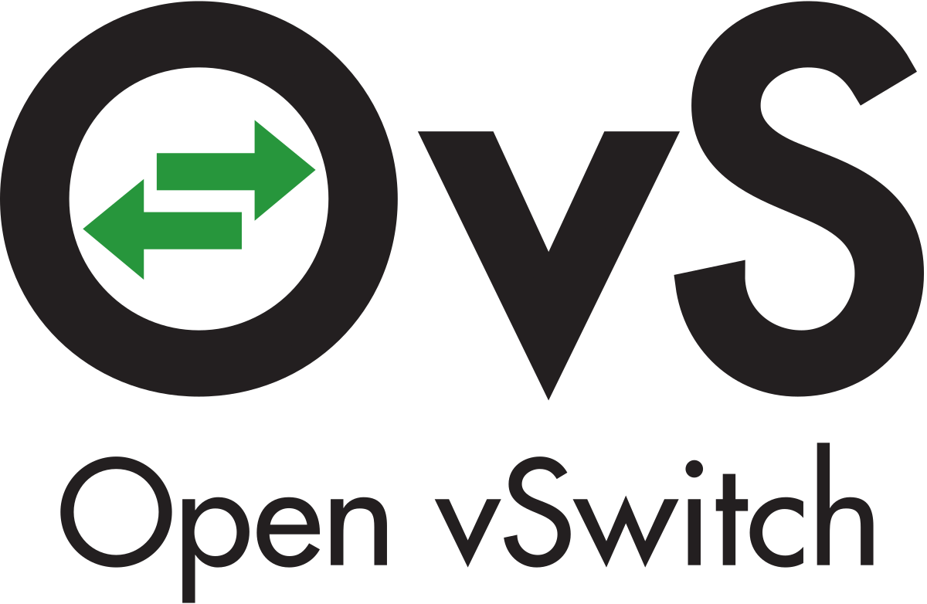
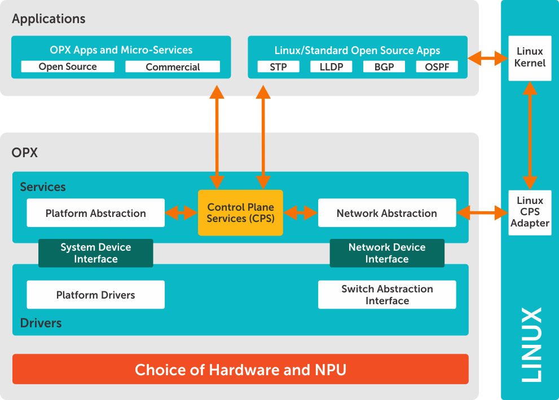

OPX
Infrastructure Layer
Management Layer
Network Infrastructure Management
(IPC, logging, etc)
CLI
SNMP
Netconf
REST
GNMI
Provides Platform Abstraction and Network Abstraction
By default supports the Linux Protocol & Application Stacks
Used as base operating system for Dell EMC Enterprise Operating OS10
Can be leveraged to write custom application using Control Plane Services API.
Production Ready, Deployed in multiple Verizon, AWINX etc.
Supported by Dell EMC
Protocol / Application Layer
BGP
STP
LACP
ACL
QoS
Abstraction Layer
Platform Abstraction
NPU Abstraction
Operating System
Drivers
Platform Drivers
NPU Drivers
Bootloader
HW
CPU
Peripherals
(FAN, LED, Sensors etc)
NPU

Slide 10
OPX Features
ACL
LLDP
BGP
Syslog
Devops
LAG
NTP
Port Profiles
VLAN
QOS
CoPP
STP
OSPF
VxLAN
VRF
IPv4 Routing
ECFM
Monitoring
IPv6 Routing
Mirroring

Slide 11
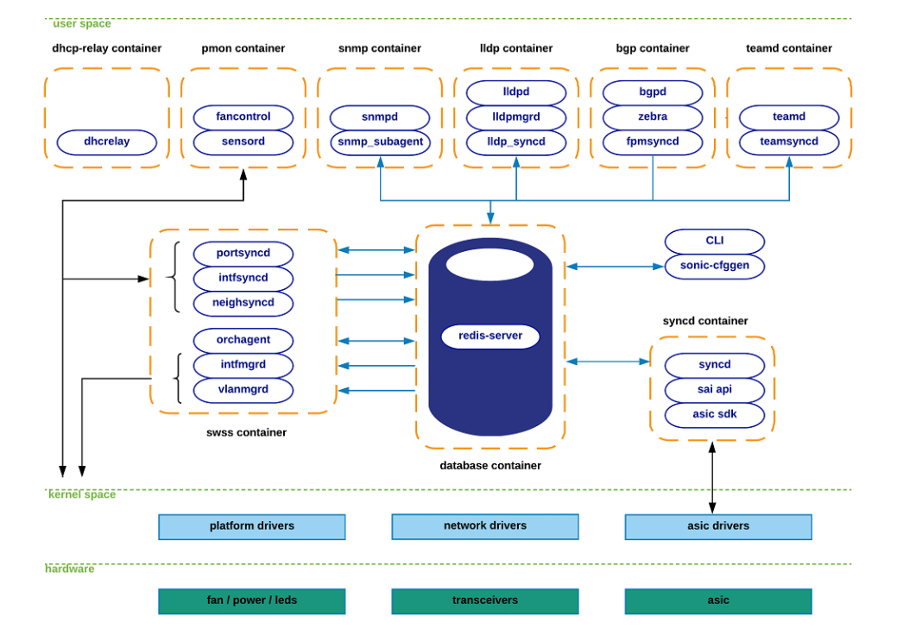
Infrastructure Layer
Management Layer
Network Infrastructure Management
(IPC, logging, etc)
CLI
SNMP
Netconf
REST
GNMI
Provides a complete NOS with the modern database and micro services based architecture.
By default supports the Linux Protocol & Application Stacks
Production Ready & Deployed by multiple web tier companies (Microsoft, Alibaba, Tencent, LinkedIn etc)
Supported by Dell EMC and Mellanox
Deployment velocity and scale
Use Cases:
Data Center Leaf & Spine
Protocol / Application Layer
BGP
STP
LACP
ACL
QoS
Abstraction Layer
Platform Abstraction
NPU Abstraction
Operating System
Drivers
Platform Drivers
NPU Drivers
Bootloader
HW
CPU
Peripherals
(FAN, LED, Sensors etc)
NPU

Slide 12
Features
ACL
LLDP
BGP MP
PFC
Devops
LAG
NTP
TATACS
Port Profiles
VLAN
QOS
CoPP
STP
OSPF
DTEL
VRF
IPv4 / IPv6
ConfigDB
ECMP
GRPC
Monitoring
L2 Mac
FIB Acceleration
Mirroring
Fast Reboot
SNMP
Notes:
Highlight DTEL coming in early before any of the integrated NOS.

Slide 13

Infrastructure Layer
Management Layer
Remote or Local Controller(s)
Network Infrastructure Management
(IPC, logging, etc)
CLI
SNMP
Netconf
REST
GNMI
New, extensible control interface GNMI, GNOI, P4 Runtime
Common models and interface for configuration, management & operations
Common Platform Abstractions
Vendor-neutral control planes
Unified device management
Simplified migration
Deployment velocity and scale
Open Source Q22019
P4 Runtime
gNMI
gNOI
Protocol / Application Layer
BGP
STP
LACP
ACL
QoS
Switch Broker Interface
Table Manager
Node/Chip Manager
Chassis Manager
Abstraction Layer
Stratum switch agent
Platform Abstraction
NPU Abstraction
Chip Abstraction Managers
E.g. ACL, L2, L3, Packet I/O, Tunnel
Platform Manager
Operating System
Drivers
Platform Drivers
NPU Drivers
user
Switch SDK
Platform API
Bootloader
kernel
Switch Chip Drivers
Platform Drivers
Shared (HW agnostic)
Chip specific
Platform specific
Chip and Platform specific
HW
CPU
Peripherals
(FAN, LED, Sensors etc)
NPU
Switch Chip(s)
Peripheral(s)
hardware
Notes:
P4 Runtime is a silicon-independent and protocol-independent API that can be autogenerated from an unambiguous definition of a packet processing pipeline in P4. P4 Runtime API can be used for local or remote control plane applications.

Slide 14
Stratum Use Cases
CORD 5G Mobile & More
Cloud SDN Fabric
Thick Switch/Router
CORD
Proprietary Network OS
(e.g. Google Espresso)
Trellis
Trellis
Embedded System
Network OS
Embedded Mgmt & Control (e.g BGP)
ONOS
ONOS
Stratum
Stratum
Stratum
Stratum
Embedded System
Embedded System
Embedded System
Data Plane
SDN
Traditional

Slide 15
Open Networking Use cases
Access
Aggregation
Core
Data Center
Access
Open Networking
Leaf
Agg
Core
Core
OPT
Spine
Access
Leaf
Integrated Stack
Access
Leaf
Agg
Core
Core
OPT
Spine
Access
Leaf
Optical Interconnect
Spine
Leaf
Applicability

Slide 16

Journey so far…
Hyperscalers
Service Providers
Enterprise
Notes:
Open Networking Journey Started from Hyperscaler trickle down to service providers and enterprise. Open Networking solutions are deployed in all the major use cases.
Similarly the Open Source Network Operating Systems are currently deployed by largescale hyperscalers & Service providers its slowly trickling down to the enterprise use cases.

Slide 17

Challenges & Call for Action?
Support
Quality
Challenges
Call for Action
Explore &
Understand
Test Drive
Deploy
Image by Peggy und Marco Lachmann-Anke
Notes:
Support – Mellanox & Dell EMC provide the support, this eco system will continue to grow..
Quality – Increasing focus on the Quality, You have heard Microsoft talk about increasing SONiC’s quality in OCP, Stratum’s Test driven approach to qualify the interfaces. ONIE and ONL certification in place, rest will trickle in
Call for action - Deliberately I left out the comparison
Understand the choice you have, look at the community support.
Test Drive - all os come with virtual environment, its as easy in couple of steps you should be able to spin them up and take it for a test drive Once you are comfortable, start deploying them non-production and then in a small controlled minimum disruptive production environment.

Slide 18


@skg-net
https://www.linkedin.com/in/skgnet
Notes:
With that thanks for listening in..
I’m Happy to take Question Please come and chat..

